Slide 1

World Happiness Index
SC1015 Group 1
Dawn Yap Shi Min (U2330053B)
Ng Yun Fei Aries (U2330271K)
Ong Beng Soon (U2330122C)
Notes:
Hello everyone! We are from Group 1. Today we will be talking about our project on World Happiness Index. I am Dawn and my group members are Aries and Beng Soon.

Slide 2
Table of contents
01
02
04
03
05
Problem Statement
Data Cleaning
Machine Learning
Exploratory Data Analysis
Conclusion
Notes:
Here is the table of content of our presentation.

Slide 3


01
PROBLEM STATEMENT
Notes:
Let’s start with our problem statement!

Slide 4
Problem Statement
What are the factors that plays the biggest role for happiness?
How can the Singapore Government ensure a happy nation?
Notes:
We will be exploring what are the factors that play the biggest role for happiness. And how can the Singapore Government ensure a happy nation?

Slide 5
02
DATA CLEANING
Notes:
Before we start our analysis, we would have to clean the datas to eliminate anomalies that can affect the trends and our analysis

Slide 6
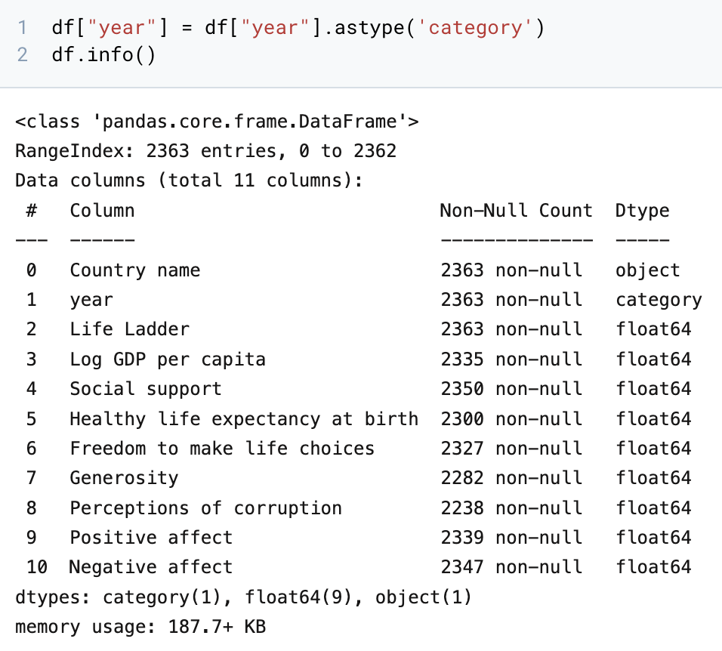
Correcting data types
Year: int64 → category
Notes:
Firstly, we will be correcting incorrect data types. The data type of variable year is incorrectly identified as integer, so we switched it to category.

Slide 7
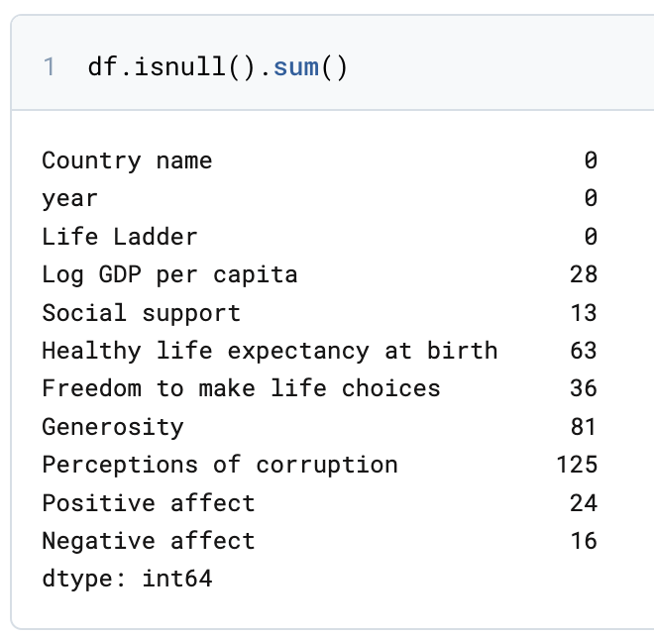
Replacing NULL values
Replacing all the NULL values with MEDIAN values
Notes:
Next, we noticed several rows with NULL datas. Since the count is insignificant as compared to the sample size, we decided to replace them with 'Median'. As compared to 'Mean', Median is more likely to preserve the underlying distribution without skewing to the outliers. this also preserve integrity of data set, where measure of central tendency is crucial.

Slide 8
Abstract relevant variables
Life ladder
Log GDP per capita
Social Support
Healthy Life expectancy at birth
Freedom to make life choices
Generosity
Perceptions of corruption
Positive affect
Negative affect
Notes:
Now with cleaned data, we will be extracting everything except for Country name and year into a new variable called cleanData, because they do not affect happiness index of a country.

Slide 9
03
EXPLORATORY DATA ANALYSIS
Notes:
Moving forward, we continued with our exploratory data analysis

Slide 10
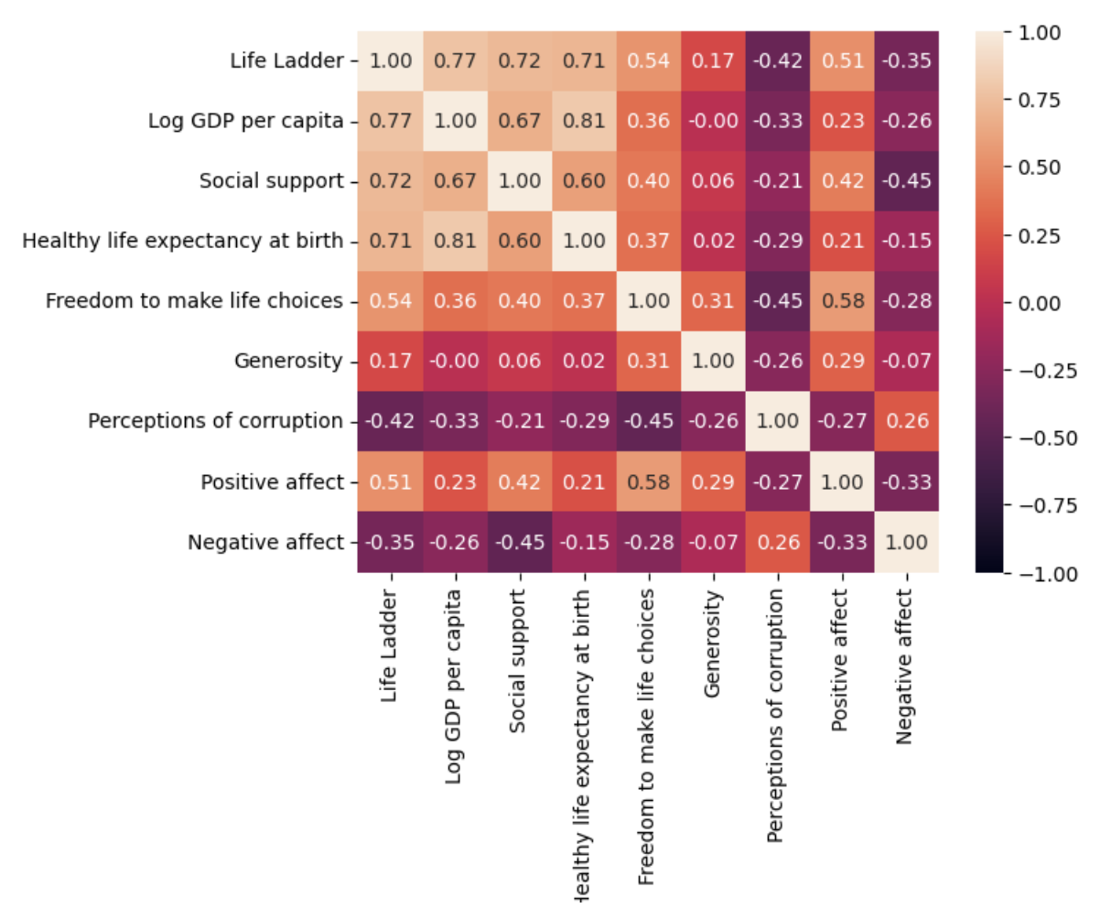
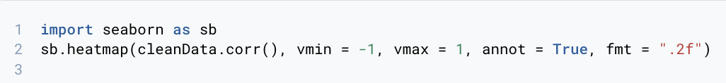
Heatmap
1. Log GDP per capita
2. Social Support
3. Health life Expectancy at Birth
4. Freedom to make life choices
5. Positive Affect
6. Perceptions of Corruption
7. Negative Affect
8. Generosity
Notes:
To explore the relationship between each variables, we performed a correlation test by visualizing the them on heatmap.
As seen in the slides the variables are in the order of strongest to weakest

Slide 11
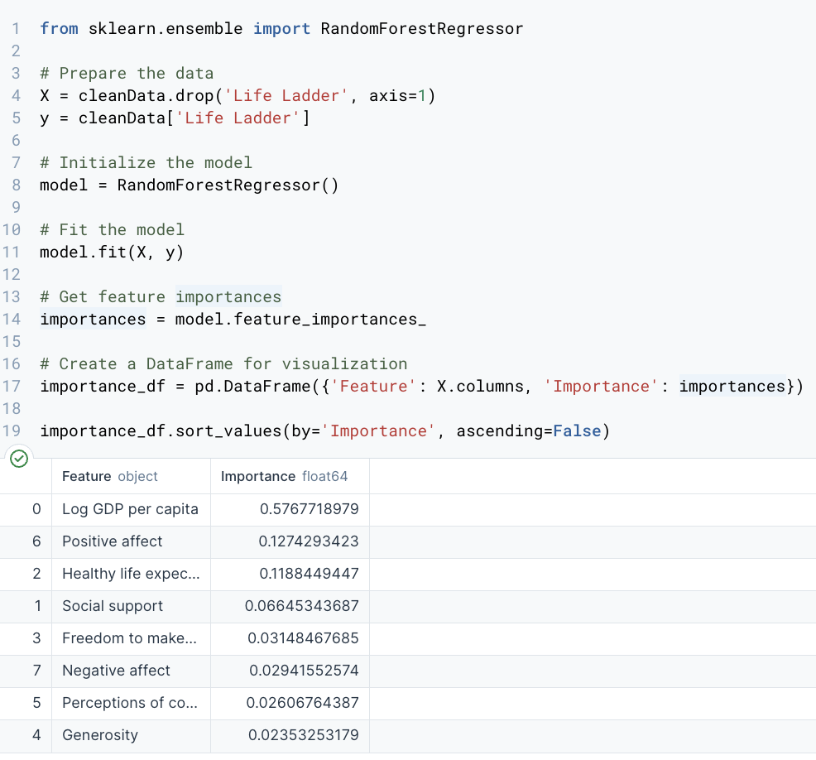
Variables to focus on
We decided to keep variables with absolute correlation value of 0.5 and above:
Log GDP per capita
Social Support
Healthy Life expectancy at birth
Freedom to make life choices
Positive affect
Notes:
Hence, based on our criteria for selecting variables with an absolute correlation value of 0.5 or higher and evaluating feature importance through a Random Forest Regressor. we will be focusing on the following variables as shown here. They demonstrated both statistical significance and predictive relevance in relation to the Life Ladder score, and will be the focus of our in-depth analysis.

Slide 12
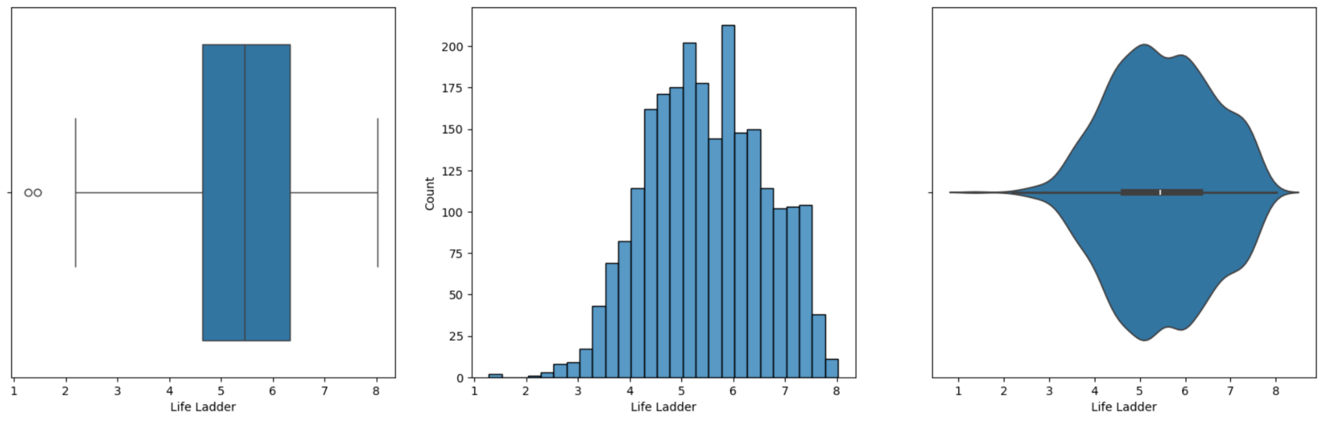
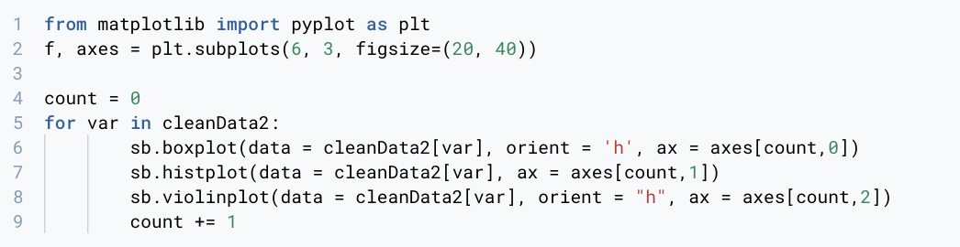
Individual box plot, histogram & violin plot
~ life Ladder ~
Notes:
Next, we plotted each individual box plot, histogram and violin plot for each variable and analyze each data separately. These are the plots for Life Ladder.

Slide 13
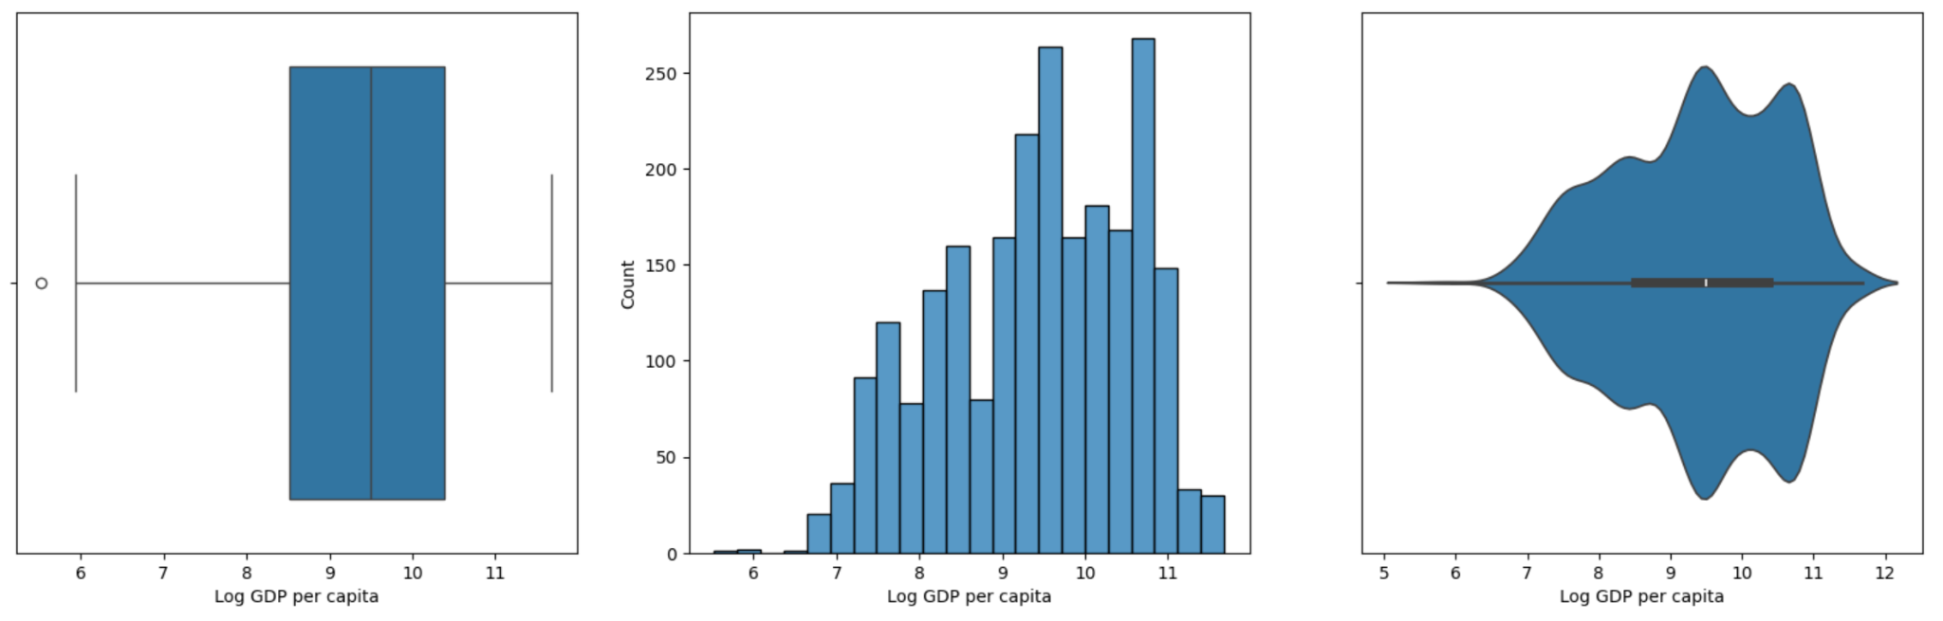
Individual box plot, histogram & violin plot
~ Log GDP per Capita ~
Notes:
These are the plots for Log GDP per capita

Slide 14
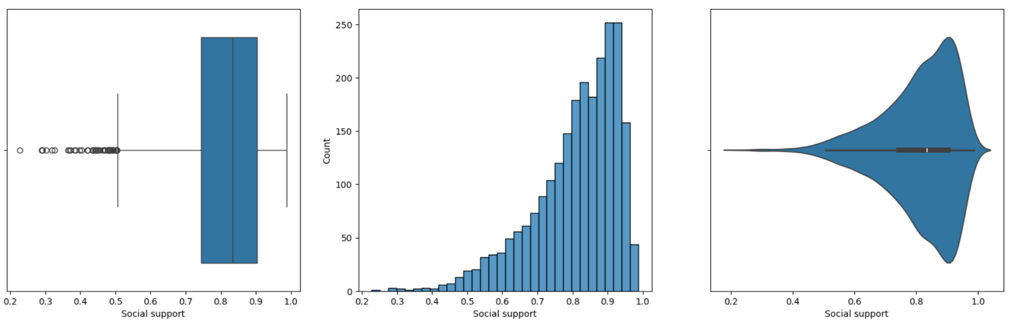
Individual box plot, histogram & violin plot
~ Social Support ~
Some outliers found
Notes:
These are the plots for Social Support

Slide 15
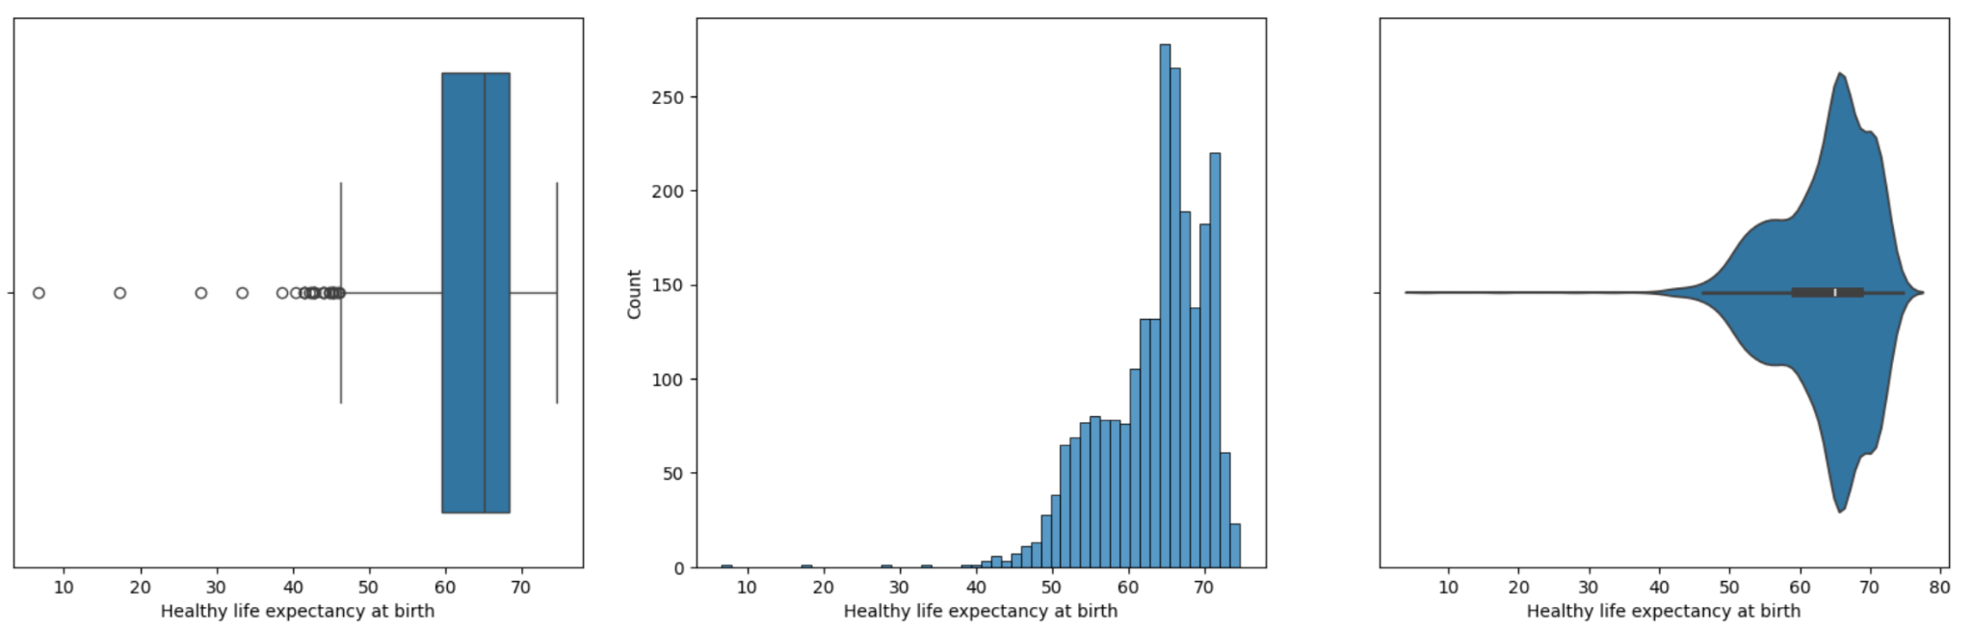
Individual box plot, histogram & violin plot
~ Healthy life expectancy at birth ~
Some outliers found
Notes:
These are the plots for Healthy Life expectancy at birth

Slide 16
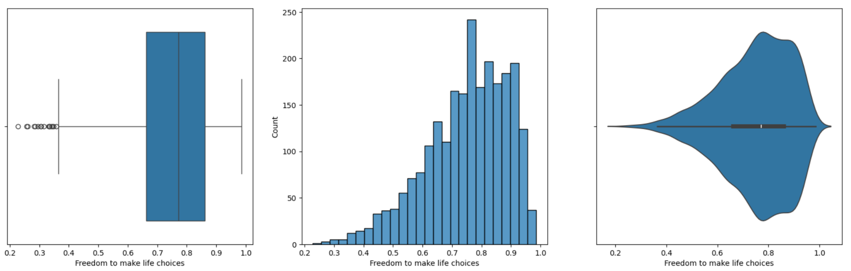
Individual box plot, histogram & violin plot
~ Freedom to make life choices ~
Some outliers found
Notes:
These are the plots for Freedom to make life choices

Slide 17
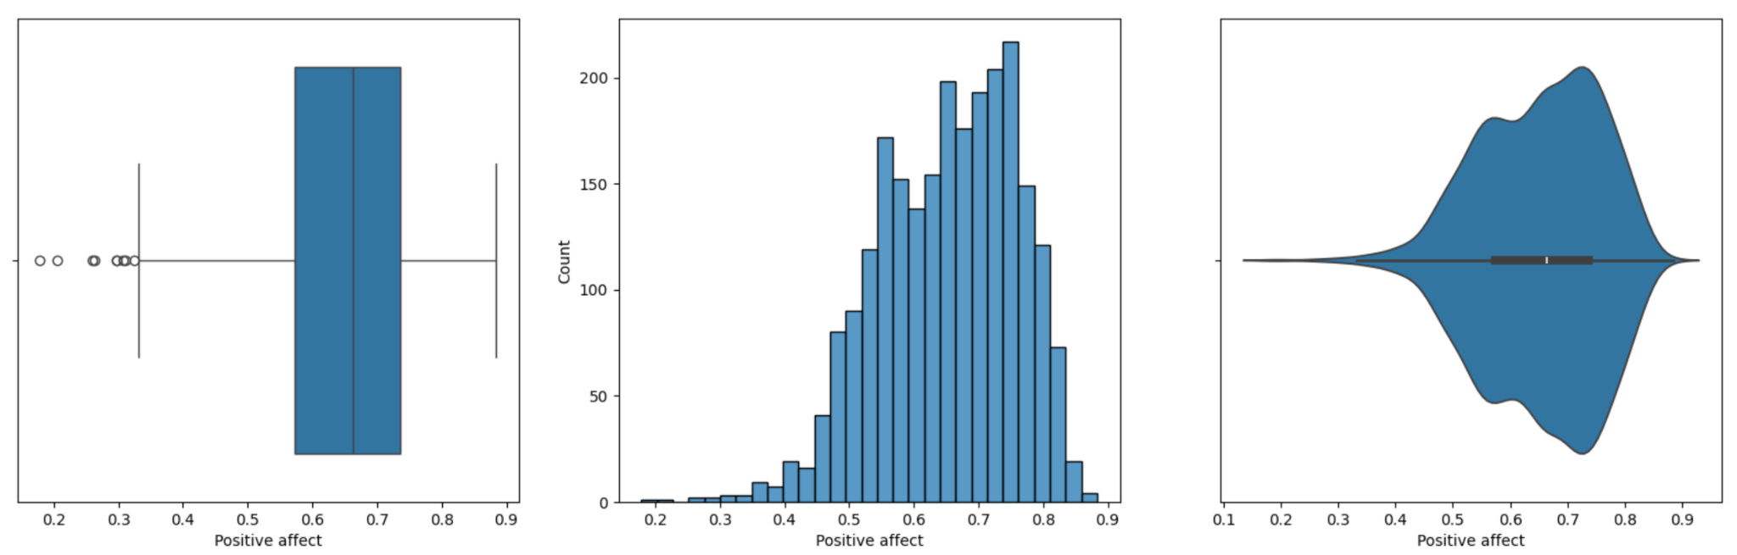
Individual box plot, histogram & violin plot
~ Positive affect ~
Some outliers found
Notes:
These are the plots for Positive affect

Slide 18
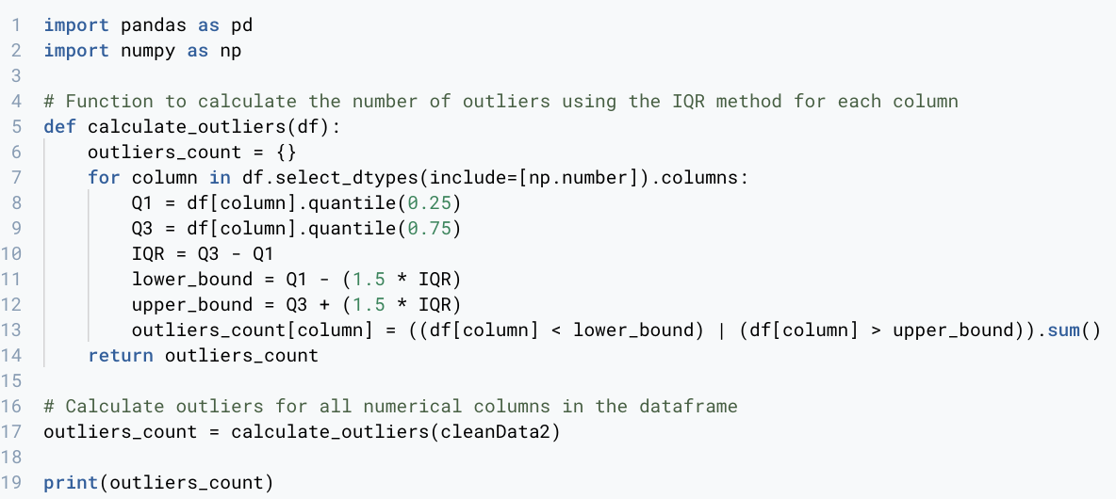
Outliers (summary)
Outliers are only a small proportion of the dataset in the variables, so it is safe to remove it without affecting the distribution significantly
Notes:
As seen in the respective box plots, there seems to be quite a number of outliers in all variables. To determine if it is safe to delete them, we need to retrieve the count of outliers.
Since the number of outliers is only a small proportion of the dataset in the variables respectively, it is safe for us to remove this outliers without affecting distribution significantly.

Slide 19
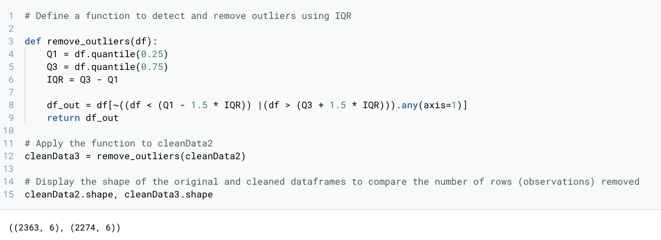
Removing outliers
Removed 89 rows of datas with outliers
Some rows have more than 1 variables with outliers
Notes:
The sum of all the outliers of individual variables is 105, but there is only a reduction of 89 rows. Howeverm, this does not imply any error as some outliers of individual variable may occur in the same row.
Essentially, the difference of 89 rows from cleanData2 to cleandata3 means that the outliers have already been removed.

Slide 20
04
Machine Learning
Notes:
Next, we will proceed with Machine Learning

Slide 21
MULTIVARIATE LINEAR REGRESSION
Machine Learning Model:
Multiple predictors: More comprehensive analysis of factors that influence dependent variable.
Linear relationship: Assumes a direct linear relationship between factors and the dependent variable.
Notes:
First, we will proceed with Multi-variate Linear Regression.
This model is essential for handling multiple predictors and understanding their collective impact on the dependent variable.
We assume direct linear relationship. As predictors vary, the dependent variable changes directionally.

Slide 22
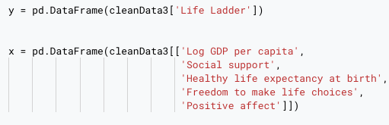
Defining the Response and Predictor
Response variable (dependent)
5 predictors (Independent)
Notes:
fter importing necessary libraries, we define 'Life Ladder' as our response variable 'y', which we aim to predict using the cleaned dataset. The predictor variables, 'Log GDP per capita', 'Social support', 'Healthy life expectancy at birth', 'Freedom to make life choices', and 'Positive affect', are assigned to 'x'. These will help explain variations in 'y'.

Slide 23
Splitting the datasets
test_size = 0.2 | → 20% will be used for testing, and 80% will be used for training. → Train and Test sets are split randomly.
Random_state = 50 | → Ensures the splits generated are reproducible
Signficance of Splitting | → Evaluates the performance of our model on unseen data
Notes:
We will split the dataset using a test_size of 0.2, allocating 20% for testing and 80% for training to allow the machine learning algorithm to learn patterns effectively. We set random_state to 50 to ensure reproducible splits. This split helps evaluate the model on unseen data and prevents overfitting.

Slide 24
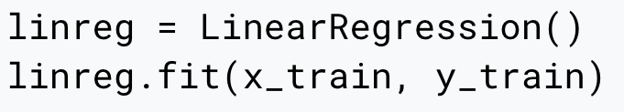
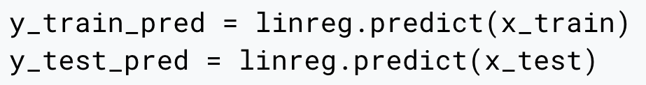
Creating Regression Model and Prediction
Creating a regression model to train the data set.
Fit the training data into the model
Predict the response variable “Social Ladder” for training and testing data
Notes:
Next, we'll create a multi-variate linear regression model using Python's LinearRegression() function. We train this model with our dataset using the fit() method to learn data patterns. Once trained, we use predict() to estimate the “Life Ladder” variable for both training and testing data

Slide 25
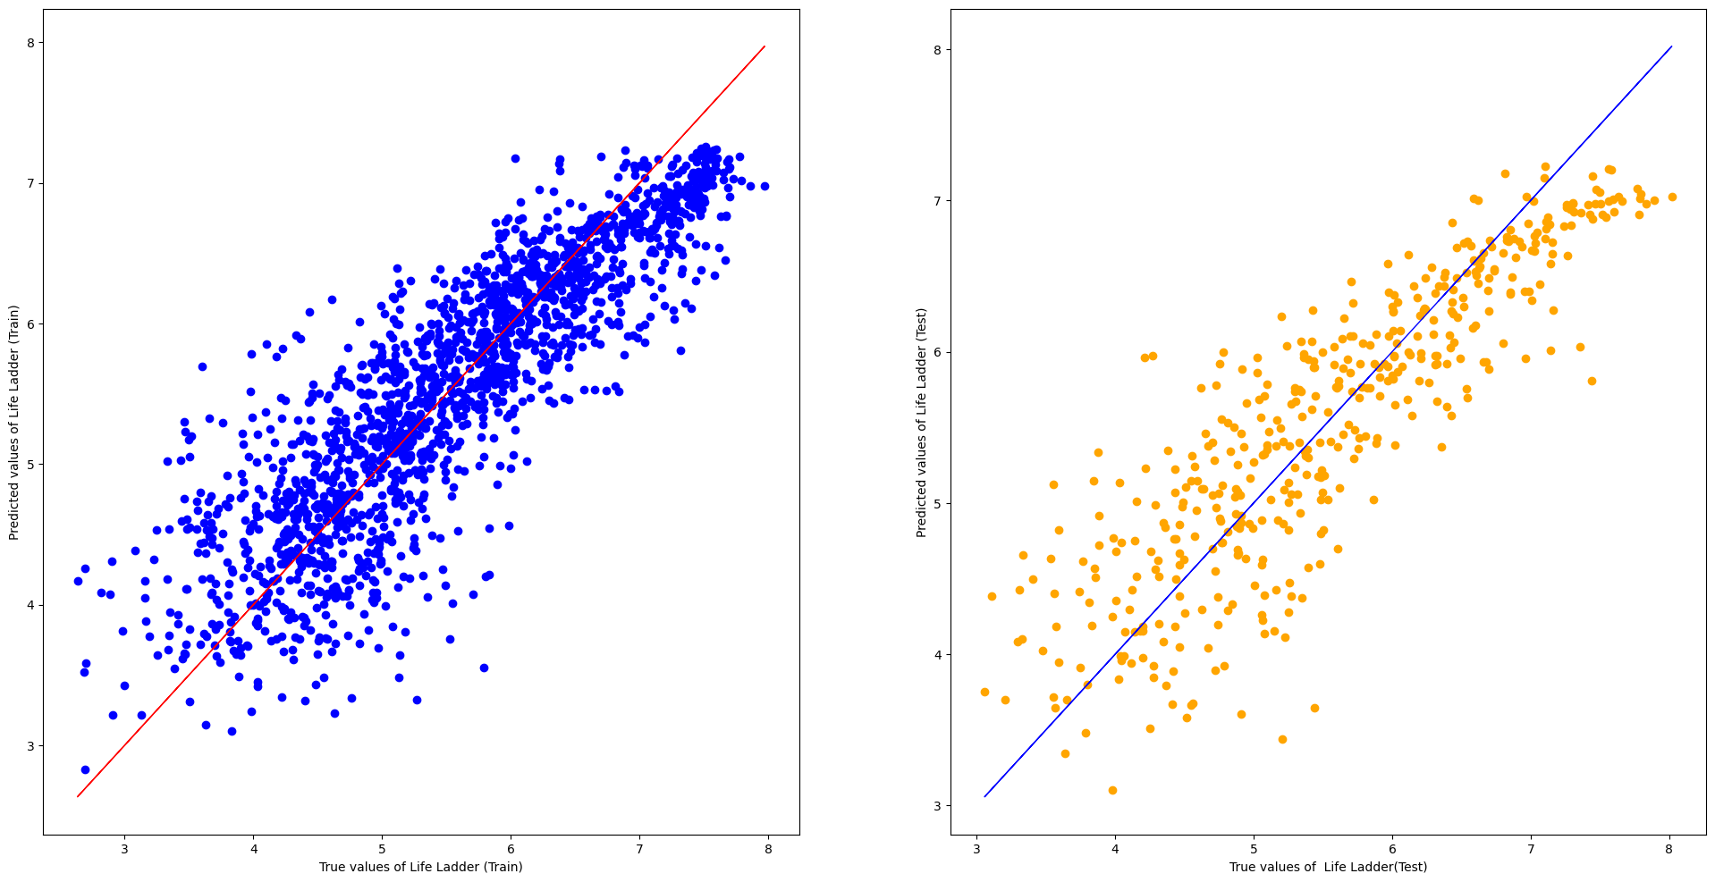
Model Performance: Training vs Testing
Consistent spread in scatter plots for training and testing sets.
Model is well-fitted
Model shows reliable predictions across seen (training) and unseen (testing) data.
Notes:
Now, we will evaluate our multivariate linear regression's model performance on both training and testing data sets. The blue and red line indicates a positive linear relationship between the predictors and the response variable respectively.
As you can see, there is a consistent spread in the scatter plots for both training and testing sets. indicating that our model is well-fitted and can generalise well to unseen data.

Slide 26
Univariate Linear Regression
Machine Learning Model:
Single predictor and one response variable:
Predictor: Log GDP per capita/ Social Support/ Healthy Life expectancy at birth/ Freedom to make life choices/ Positive affect
Response: Life Ladder
Significance of Variables: Impact that the predictor variable has on the response variable
Notes:
Univariate Linear Regression is a type of linear regression where we have one predictor variable and one response variable. The goal is to find a linear relationship between these two variables. In our analysis, we will proceed with univariate linear regression to rank the significance of the predictors.

Slide 27
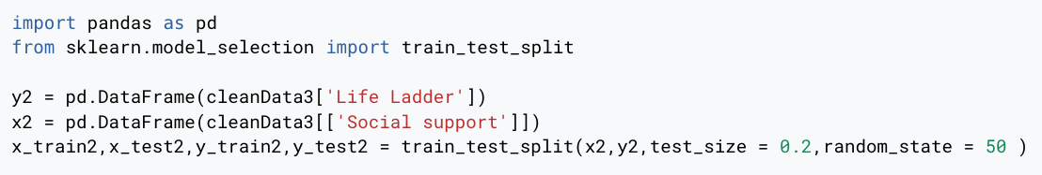
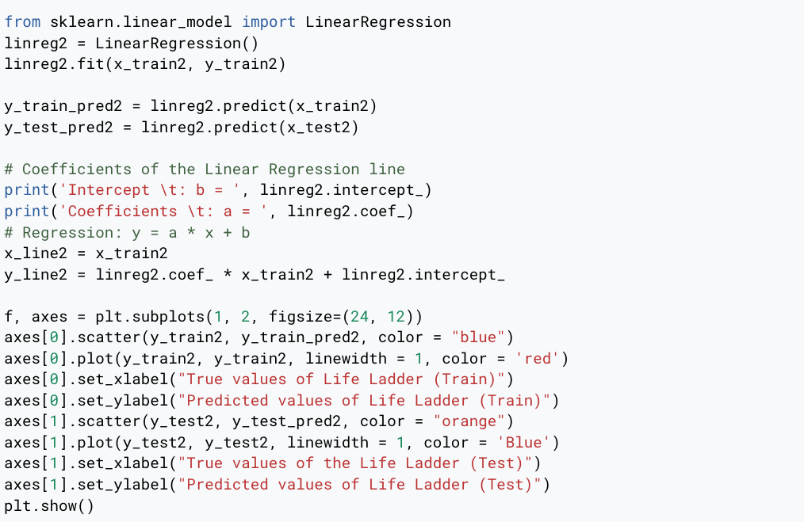
Code for Univariate Regression
The red portion will be changed accordance to the variable we are using for each regression
Notes:
This is the code for univariate-regression. The steps are similar to the ones in multivariate regression, except for only having one independent variable. The same code will be used for each univariate regression, with change only in the variable names and the highlighted portion as shown in the slide

Slide 28
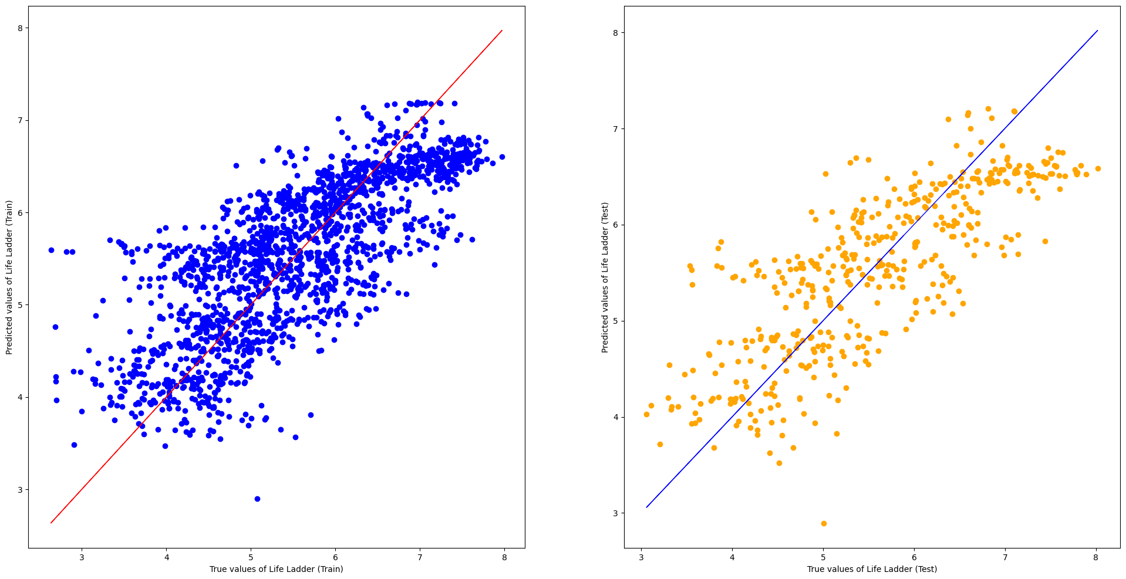
Log GDP per capita and Life Ladder
Notes:
In this case, Log GDP per capita is our predictor, and we have created scatter plots for both testing and training data sets.
Below the graphs, we provide metrics including Train MSE, Test MSE, and Explained Variance for both training and testing phases to quantify our observations.

Slide 29
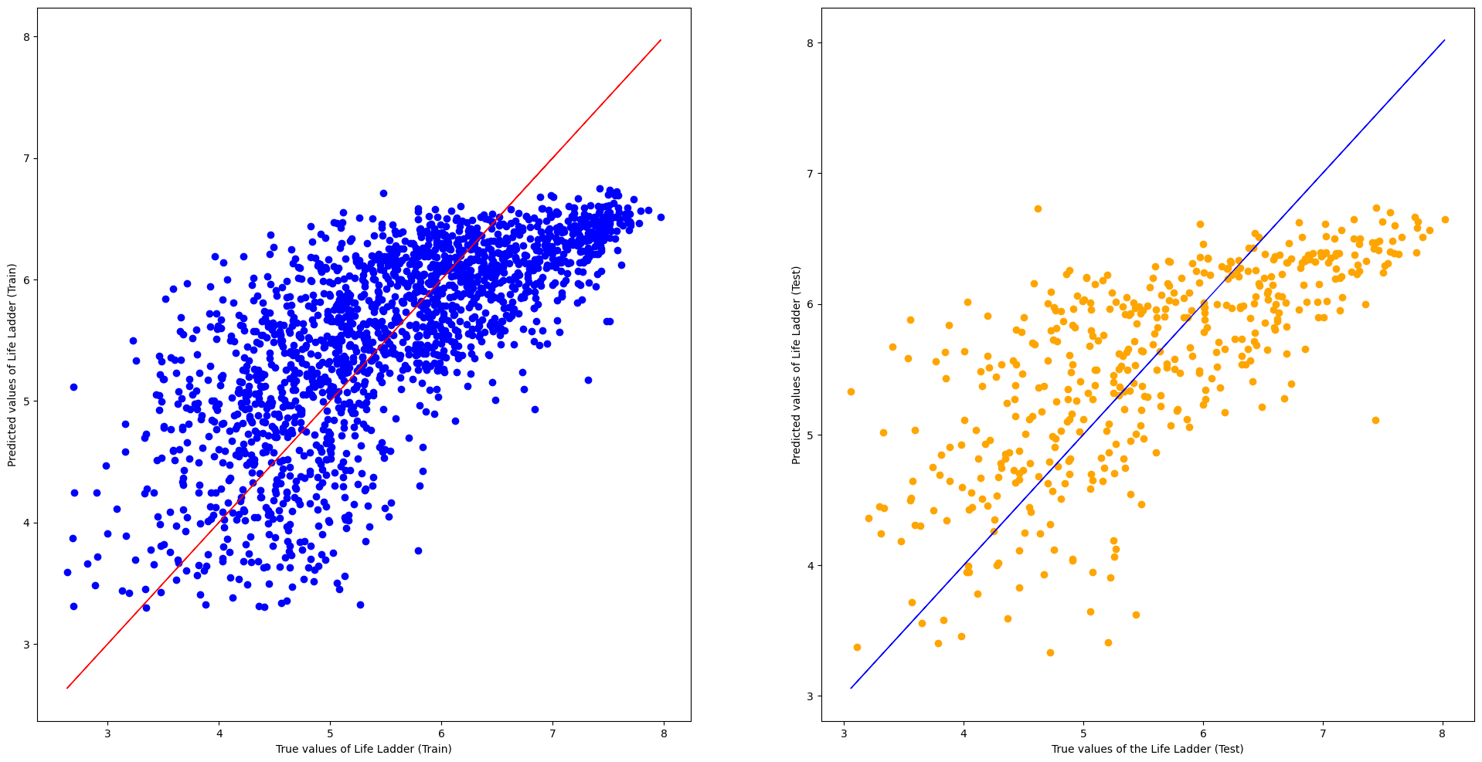
Social Support and Life Ladder
Notes:
Next, we apply the same process to Social support and life ladders.

Slide 30
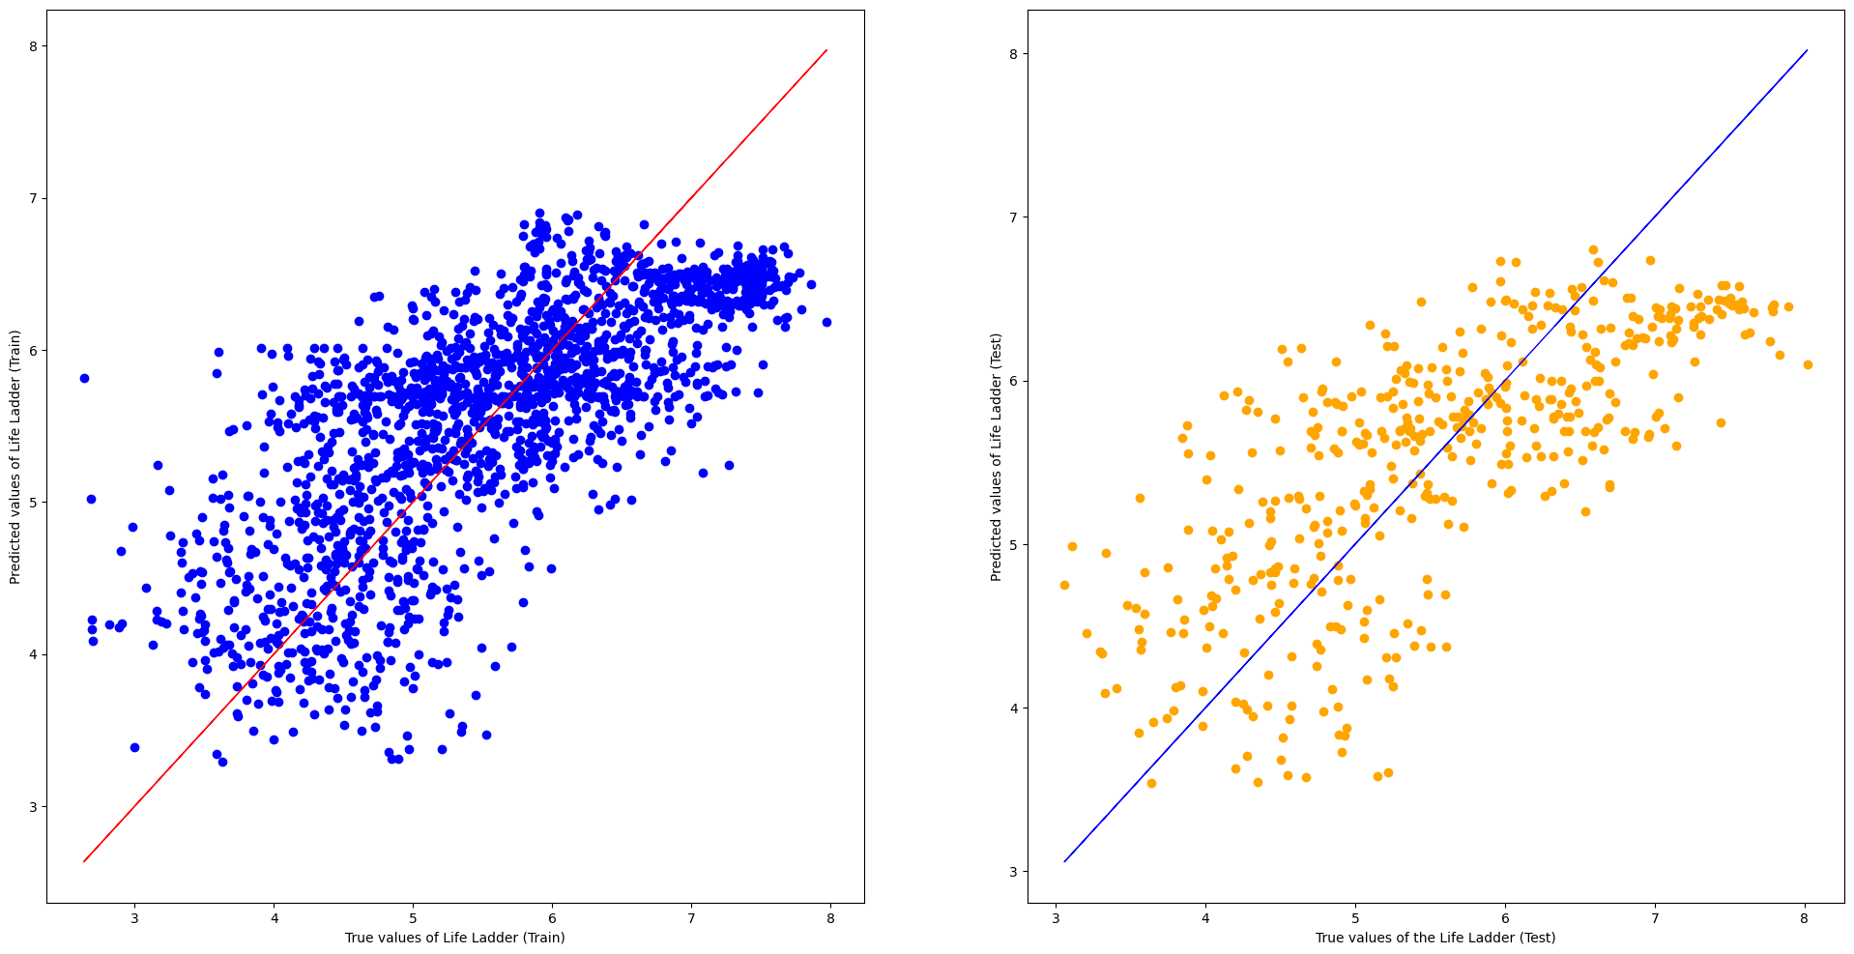
Healthy life expectancy at birth and Life Ladder
Notes:
The same goes for predictor, Healthy life expectancy at birth.

Slide 31
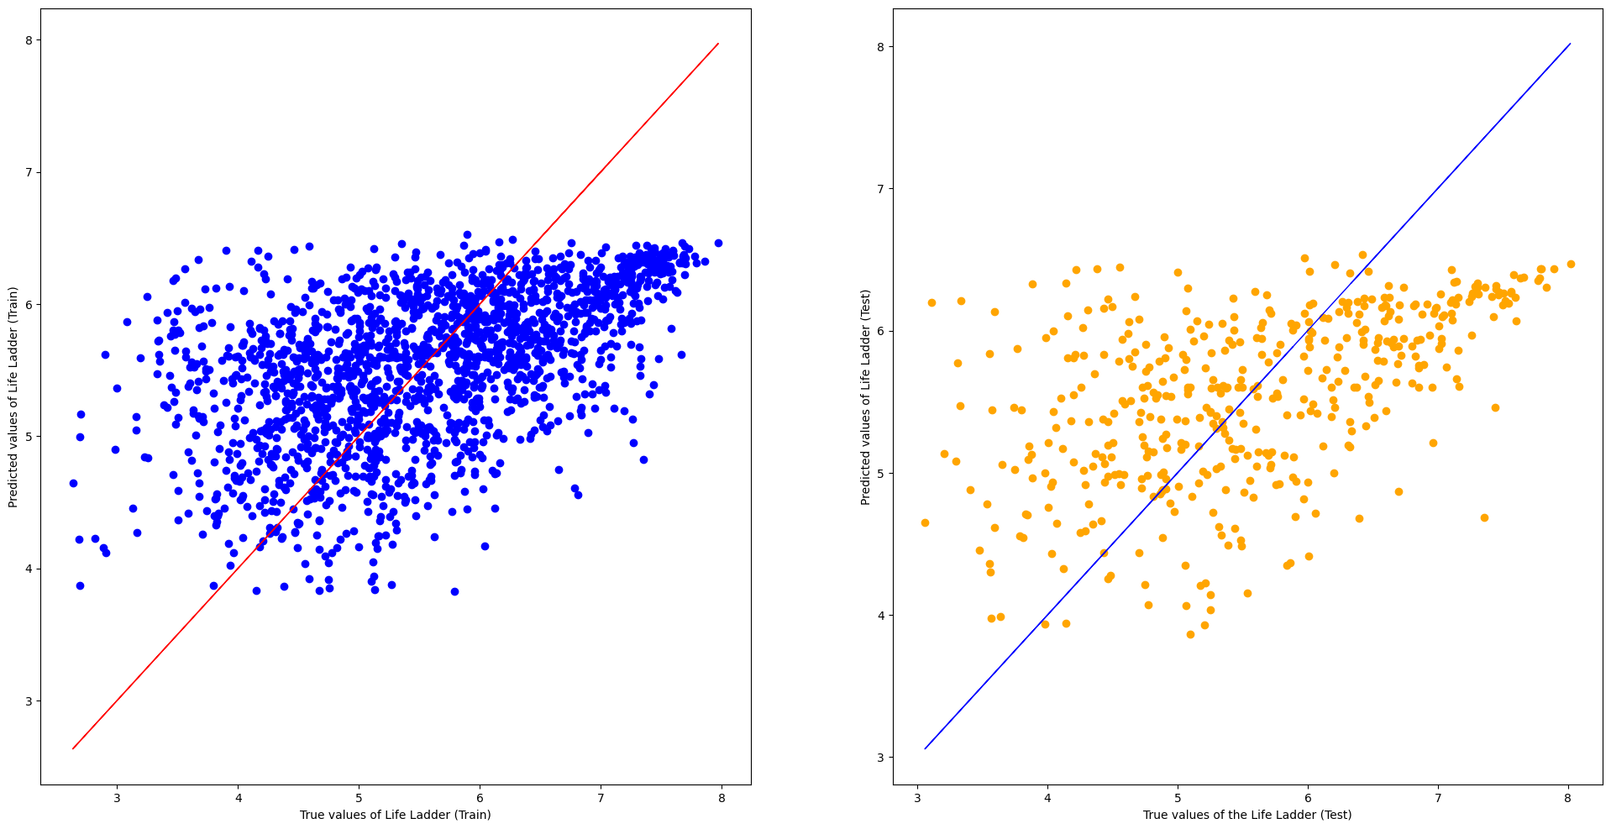
Freedom to make life choices and Life Ladder
Notes:
The same goes for predictor, Freedom to make life choices.

Slide 32
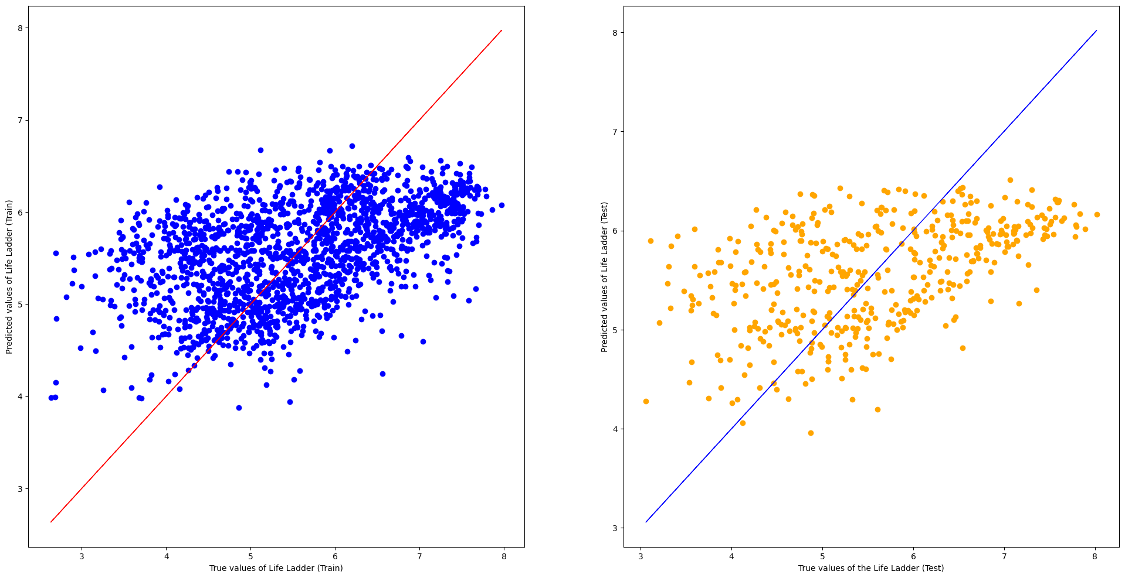
Positive affect and Life Ladder
Notes:
Lastly, these are
the scatter plots for the predictor:Positive affect and the response variable.

Slide 33
Metrics used for Goodness of Fit
Explained Variance (R²):
proportion of the variance in the dependent variable that is predictable from the independent variable in training and testing set.
Higher value → reduces uncertainty in prediction
Mean Squared Error (MSE):
average squared difference between observed actual outcomes and the values predicted by the model.
Lower value → better accuracy in predictions by the model
Notes:
We assessed our regression model using two key metrics:
First, we have explained variance.This measures the proportion of variance in the dependent variable predictable from the independent variables.
A higher R² value reduces uncertainty in prediction, increase reliability
Next, we have MSE. This is the average squared differences between actual and predicted values. A lower MSE indicates higher accuracy in predictions.

Slide 34
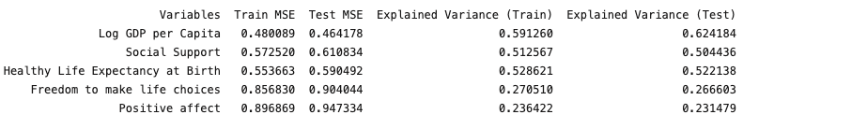
Goodness of Fit for each model
Similar “Train” and “Test” MSE suggests model is not overfitting
Notes:
Similar "Train" and "Test" MSE indicate that the model is not overfitting

Slide 35
Ranking the predictors
Based on the Explained Variance and the MSE, the following variables are more likely to affect the response variable (Life Ladder):
Log GDP per capita
Healthy Life Expectancy at Birth
Social Support
Freedom to make life choices
Positive affect
Notes:
Using the Explained Variance and Mean Squared Error, the variables are ranked in order of their significance on the response variable, Life Ladder. The ranking is shown in the slide.

Slide 36
Refinement to the Multivariate Linear Regression model
Step: Isolate and focus on the three key predictors for the next iteration of the model.
Objective: To see if refining the model helps to improve the prediction accuracy.
Notes:
Now, we will move on to the refinement process applied to the multivariate linear regression model. The first step is to isolate and focus on the three key predictors for the next iteration of the model. The objective of this refinement process is to improve the prediction accuracy of the model, minimising errors in the predictions.

Slide 37
Key Predictors
Log GDP per capita
Healthy Life Expectancy at Birth
Social Support
Do a refined multivariate linear regression using these 3 variables
Notes:
After identifying the top three predictors, we will use them to do a refined multivariate linear regression.

Slide 38
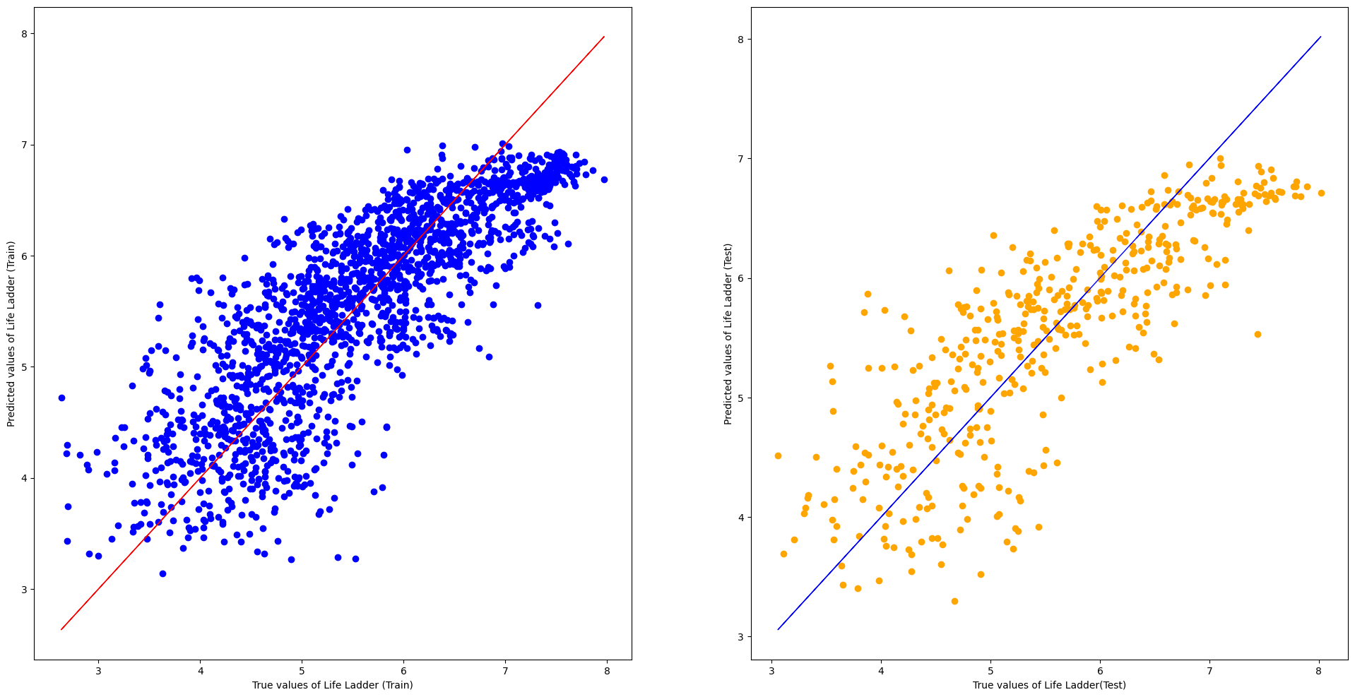
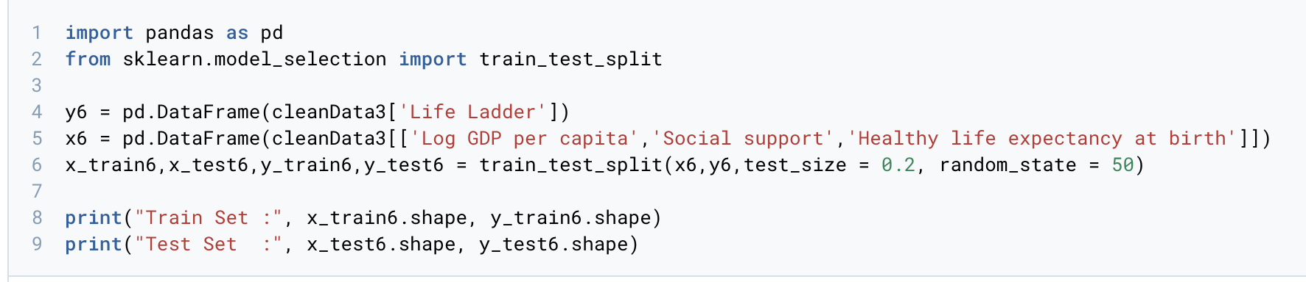
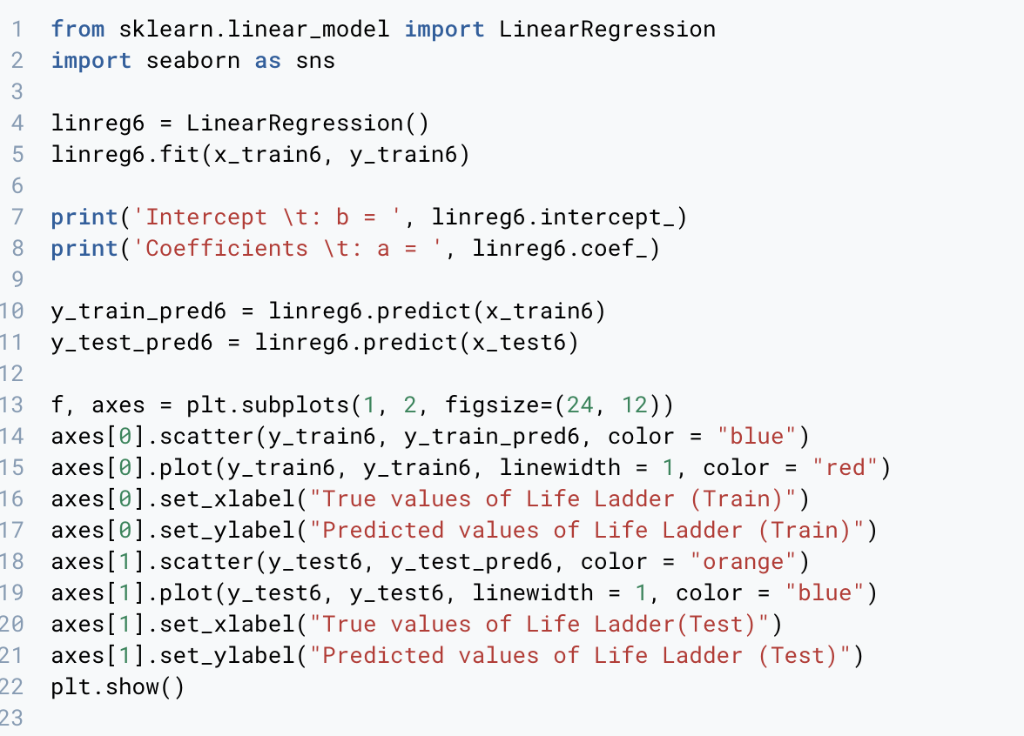
Multivariate Linear Regression (3 Variables)
Notes:
Here is the code and scatterplot for the multivariate linear regressions with three predictors. There is a consistent spread in the scatter plots for both training and testing sets. This consistency indicates that our model is well-fitted and can generalise well to unseen data.

Slide 39
Comparing Model Performances
Linear Regression model with removal of “Freedom to make life choices” and “Positive affect” fares worse :
Increase in MSE (Test and Train)
Decrease in Explained Variance (Test and Train)
Hence, we will continue utilising 5 variables when utilising other machine learning models.
Notes:
The Linear Regression model fares worse after the removal of “Freedom to make life choices” and “Positive affect”. This is indicated by an increase in MSE (Test and Train) and a decrease in Explained Variance (Test and Train).
Hence, we will continue to use all 5 variables when applying other machine models to ensure better performance.

Slide 40
XGBOOST
Machine Learning Model:
Gradient-Boosted Decision Tree
Combines multiple ML models to obtain better model
Better prediction of the model
Used for regression and classification problems
Notes:
XGBoost is a machine learning model which utilizes gradient-boosted decision tree. It is similar to the Random Forest, where it combines multiple machine learning algorithms to obtain a better model. For XGBoost, it combine a single weak model with other weak models to make a single strong model which allow for more accurate prediction.

Slide 41
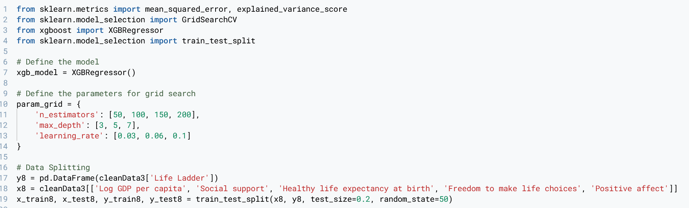
Creating the Dataset
Import the relevant modules
Define model and parameters
Create train test split for dataset
Notes:
after importing relevant modules, we defined the model using XGBRegressor. Then, we fit the parameters into grid search to find the best for our models. We use variance_estimators, max depth and the learning rate as they affect the accuracy of our model.

Slide 42
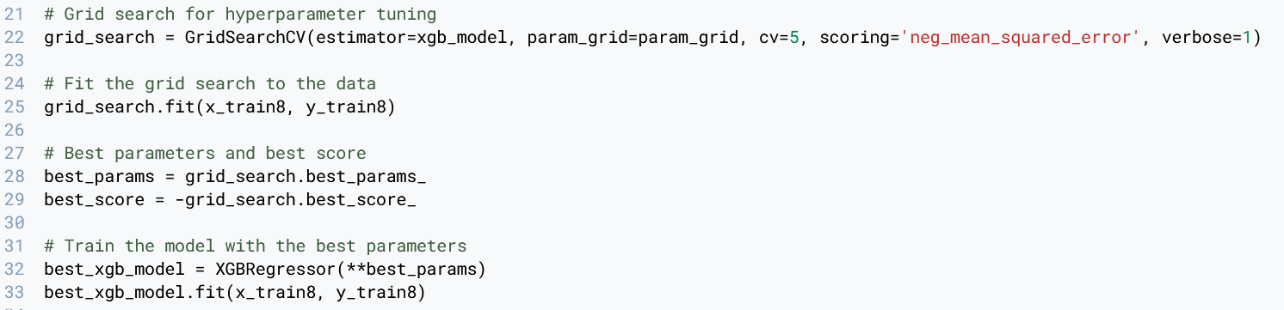
Fitting the Model with GridSearch
Notes:
Next, we varied cv and found that 5 gives the best result, scoring will be MSE and verbose is 1. Next we fit the train data into grid search.

Slide 43
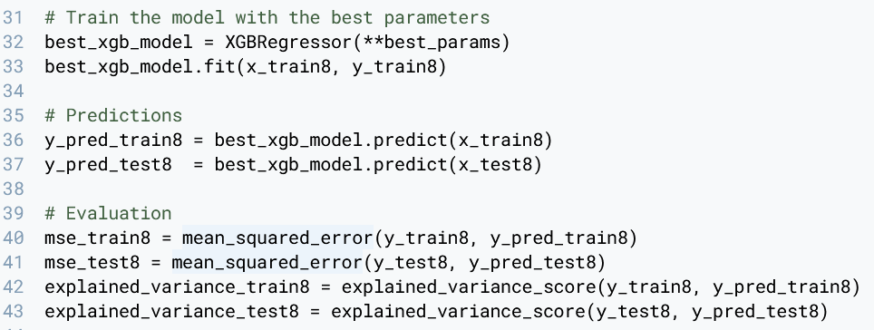
Accuracy of the Model
Notes:
Next, we train the model and use it to predict the output. We note down the MSE and explained variance for both the test and train data

Slide 44
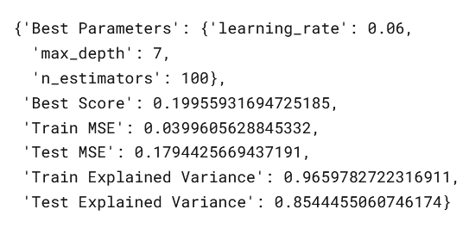
Best Parameter
Notes:
Based on grid search, the best parameters are a learning rate of 0.06, max depth of 7 and n estimators of 100. The data is shown below

Slide 45
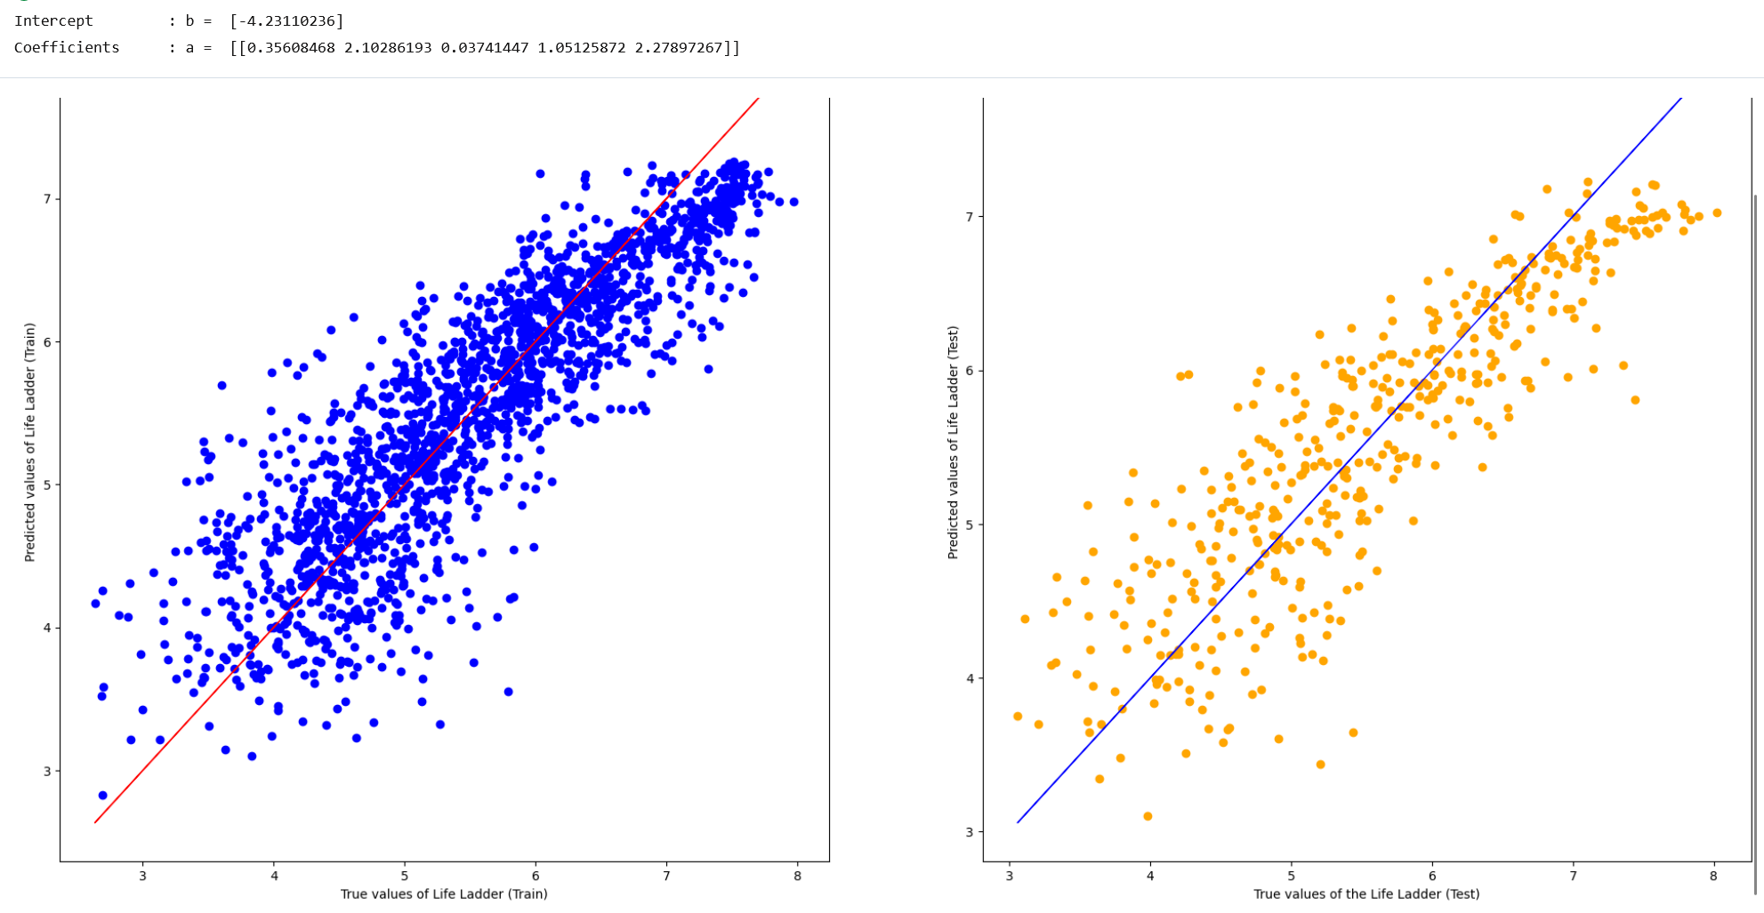
Multivariate Linear Regression
Notes:
Next we plotted our model and we found that the results are consistent with the MSE and explained variance is and well fitted

Slide 46
Tensor Flow
Framework of Machine Learning and Deep Learning:
Tensor is a multidimensional array
Flow is used to define the flow of data in an operation
Has hidden layer and neurons to facilitate deep learning
Efficient handling of complex computations
Notes:
Tensor Flow is a framework of machine learning and deep learning models. Tensor is a multidimensional array while flow is used to define the flow of data in an operation. It has many hidden layers and neurons to facilitate deep learning and is efficient in handling complex computations

Slide 47
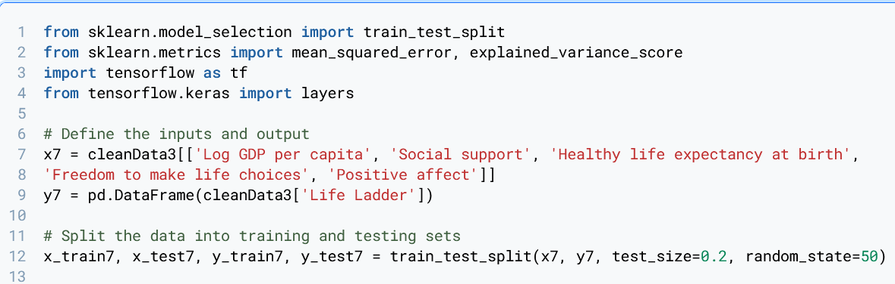
Creating the Dataset
Import the modules
Split into train test data
Notes:
First we import the relevant modules then we split the dataset

Slide 48
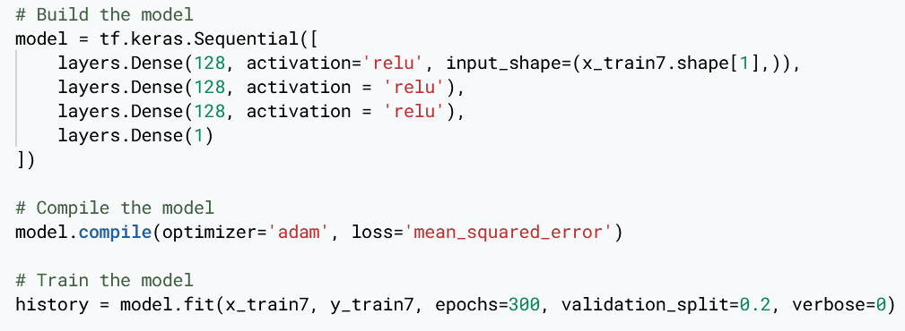
Creating the Model
Notes:
We start off with a layer of 64 neuron, then slowly increase the number of layers. Once we found the optimal layers, we configured the number of neurons in order of 64, 128 and 256. We have the best result when we used 128 neurons and 3 hidden layers. For our activation function, we chose to Relu as our output is non negative, it also deals with the vanishing gradient problem, allowing us to train the model with many hidden layers effectively. We chose the adam optimizer as it is robust, efficient and have an adaptive learning rate. Adam would adjust the learning rate for each weight in the model individually and this helps in handling the sparsity of data and the different scale of parameters. Our loss is to minimize MSE. For epochs, we gradually increase it until we found the optimal number which is 300

Slide 49
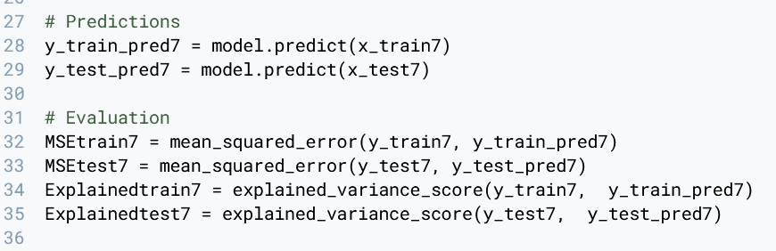
Accuracy the Model
Notes:
Next, we find the accuracy of our train data to predict the train and test output

Slide 50
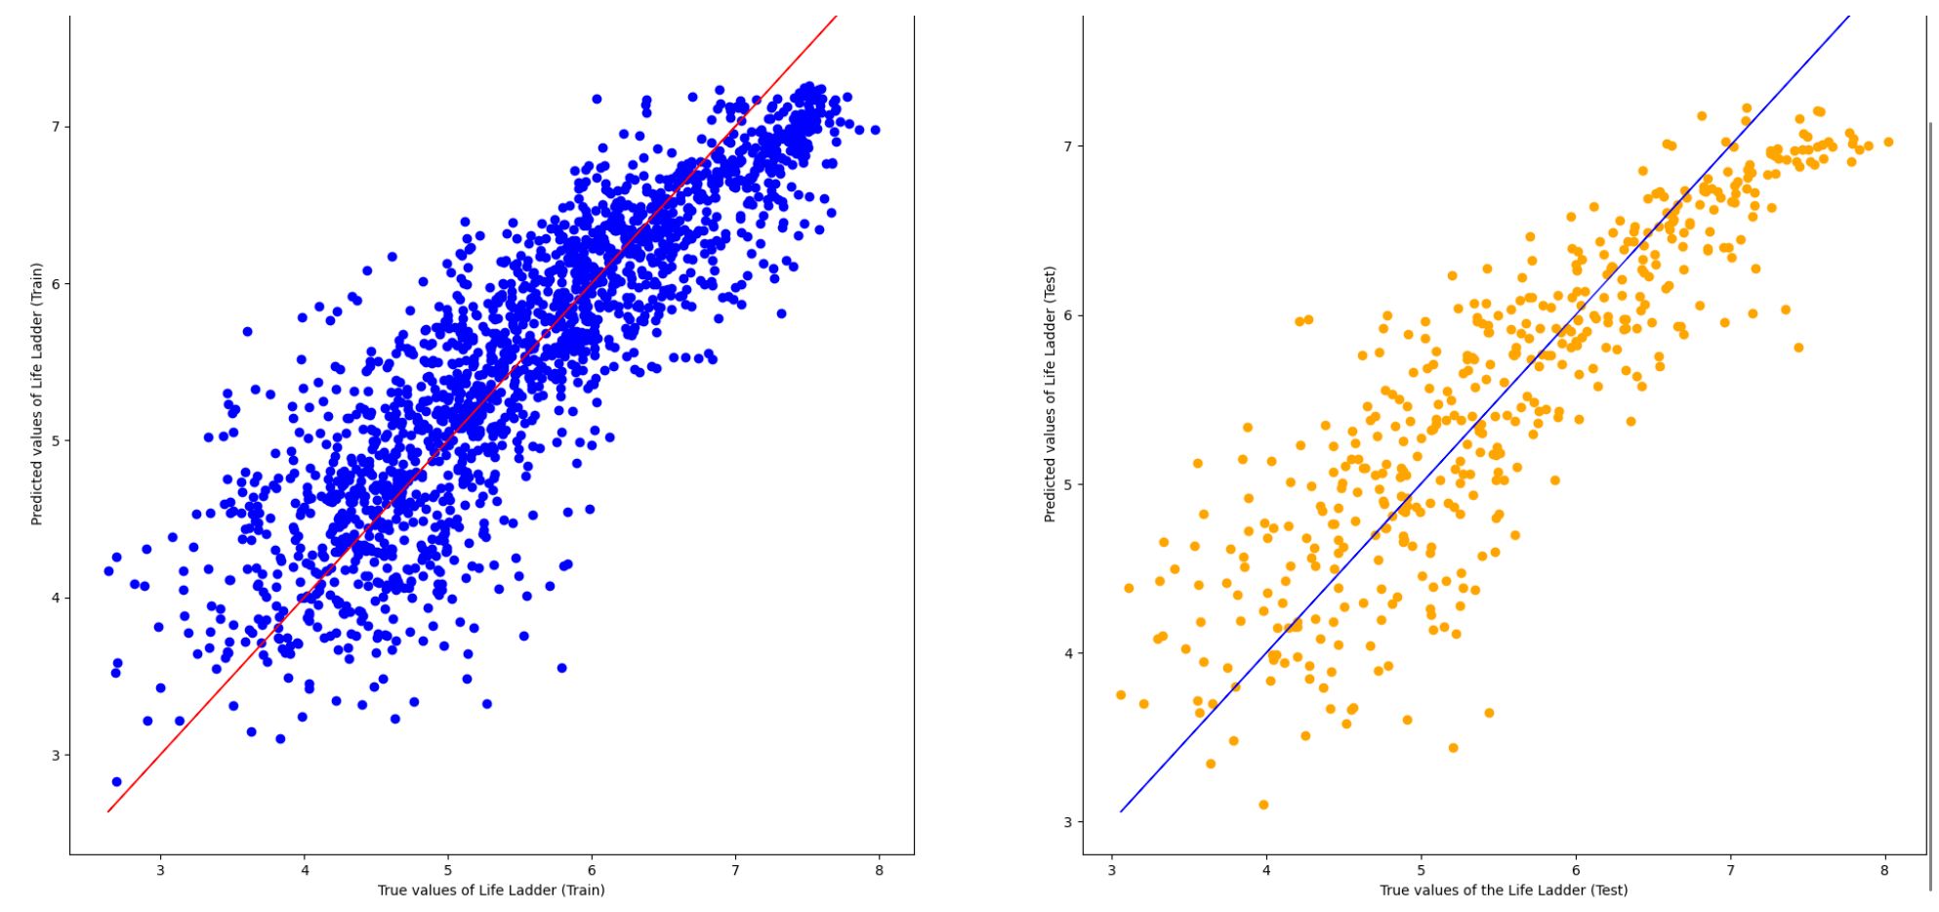
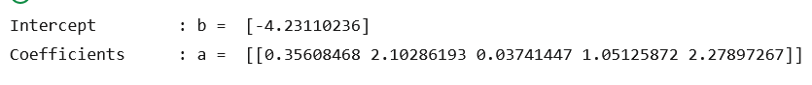
Multi-Variate Linear Regression
Notes:
We plotted our model and found that it is consistent with our findings, making it is well fitted

Slide 51
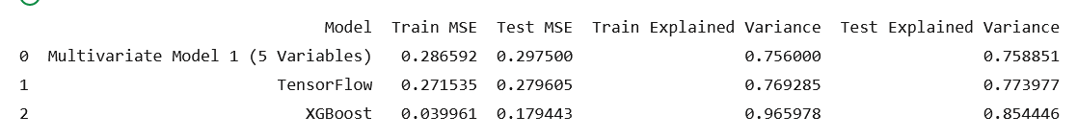
Overall Results
Notes:
Overall, XGBoost performed the best for MSE and explained variance, making it the best model for predicting happiness

Slide 52
Conclusion
Important Determinants
Best Model
Log GDP per Capita
Social Support
Healthy Life Expectancy at Birth
XGBoost
Notes:
To conclude, we found that the most important determinants are log GDP per Capita, social support and health life expectancy at birth. And the best model for predicting happiness is XGBoost

Slide 53
Recommendation
Singaporean Government to prioritise on:
Log GDP per capita (Maintaining a healthy economy)
Social Support (Creating a vibrant community)
Healthy Life Expectancy at Birth (Affordable healthcare)
Use XGBoost for better prediction
Notes:
We recommend that the Government focus on log GDP per capita by maintain a healthy economy, social support by creating a vibrant community and healthy life expectancy at birth by making health care affordable. For the statistics team, we recommend them to use XGBoost to better predict and forecast the performance of the government’s effort in the happiness in Singapore

Slide 54
Learning Outcome
XGBoost
Random Forest Regressor
GridSearch
Tensor Flow
Deepnote collaboration
Collaboration of a single notebook on an online platform
Notes:
Through this project, we have learnt XGBoost, Random Forest Regressor, grid search, tensor flow and how to collaborate in deepnote

Slide 55
Thank You!

